Slide 1
Earth Observation Exploitation Platform Hackathon 2018
March 2018
Dr. Ingo Simonis
Open Geospatial Consortium

Slide 2
Agenda
13:30 – 13:45
Patent call, introduction, admin
13:45 – 14:05
What do we want to do?
14:05 – 14:25
Application, clouds
14:25 – 15:00 discussion

Slide 3
Why we are here today?
Sponsored by ESA and NRCan
Idea developed at the Testbed-13 Final Demonstration Meeting
Evaluate if the Testbed-13 Earth Observation Clouds (EOC) results work in practice

Slide 4
Admin
PA: Reduced to single page
Most importantly: Patent call

Slide 5
Patent Call
Please be aware that this initiative is being conducted under the OGC Policy Regarding Intellectual Property Rights (available at http://www.opengeospatial.org/about/ipr).
At this time, I would ask that anyone in attendance inform me if they are personally aware of any claims under any patent applications or issued patents that would be likely to be infringed by an implementation of the standard or other work product which is the subject of this initiative.
You need not be the inventor of such patent or patent application in order to inform us of its existence, nor will you be held responsible for expressing a belief that turns out to be inaccurate.

Slide 6
Who is who and why are you here
30sec each ☺

Slide 7
Admin
PA: Reduced to single page and to “Feedback Agreement”
Cost compensation: EUR 4k lump sum, purchase order, details soon
Participation at the final demo meeting May 3-4 in Darmstadt is obligatory
Some emails, but very few phone conferences
Github at https://github.com/opengeospatial/EOEPHackathon2018

Slide 8
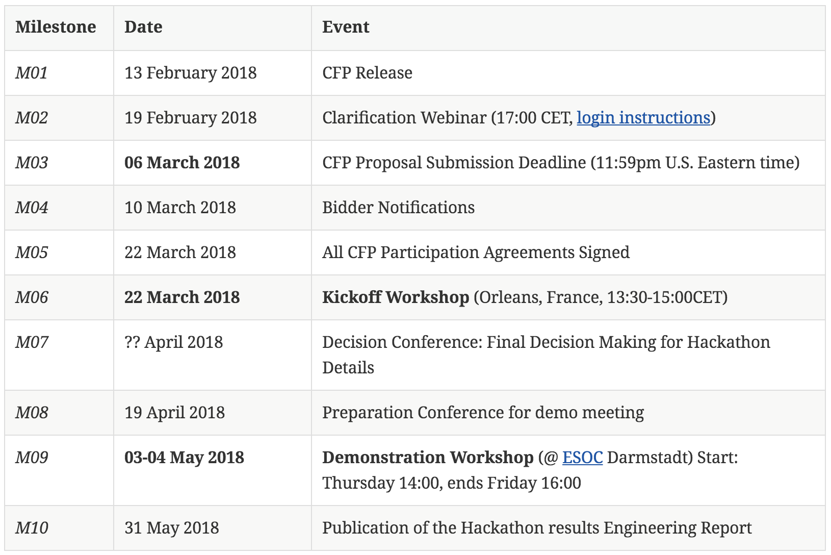
Master Schedule

Slide 9
Application
developer
Application
consumer
Notes:
Typical situation: on the one side is the application developer, who creates an application, on the other side is the consumer.
How can the developer make the application available in the cloud so that the consumer can use it?

Slide 10
Dynamic registration of
new apps
Application
developer
Minimize effort for app developer
Consumers use their
own data
Dynamic scaling of
cloud environment
Application
consumer
Results at
OGC Web services
Notes:
T13 requirements

Slide 11
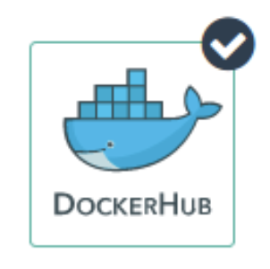


1
Application
developer
5
2
Application
consumer
3
6
4
Notes:
6th step: application consumer provides all execution information to the application platform

Slide 12
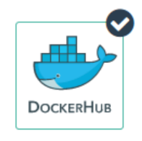
Application
developer
IAAS
AWS
WPS
WPS
IPT Poland
WFS
CSW
WCS
WMS
Application
consumer
Notes:
Let’s change to a more schematic perspective: Here we see that a number of OGC Web services are deployed.
The left WPS manages all the application packages, whereas the right one deploys requested containers in the cloud and executes them.
Data can be accessed through standard OGC data access services.

Slide 13
Future Work
Application Builder
Wizard to build the OWS Context document
Wizard to Dockerize application
Standardized and standardized handling of output data
Application Deployment & Execution
More info about application in AP, e.g. infrastructure resource requirements, parallelization options etc.
Test more complex applications, e.g. multi-cloud
Security
Bulk windowed execution, continuous periodic generation
Quotes, accounting/billing

Slide 14
What we want to do -1
Canada’s forest cover an area of 348 million hectares, which is 35% of Canada’s land area and 9% of the world’s forested area.
Because vast areas are inaccessible, researchers use satellites such as Sentinel-1 to gain valuable insights into Canada’s forest ecosystem.
The Hackathon shall evaluate the extent of wild fires based on Sentinel-1 data for the summer of 2017 over the Northwest Territories, Canada.

Slide 15
What we want to do -2
Organizers will provide the Sentinel Application Platform (SNAP) Software Toolbox together with a pre-defined workflow packaged in a Docker container.
Hackathon participants can use the Docker container "as is" and do not need to modify the container or the application.
The SNAP workflow in that Docker container requires two types of data: Digital Elevation Model (DEM) data and Sentinel-1 data. Both will be made available to the participants as cloud resources.

Slide 16
3 Steps Process
Application Package definition
Setup of an ADES (WPS 2.0)
Process deployment & execution on clouds

Slide 17
1st Step: Application Package Definition
Participants need to develop the Application Package for the application in the Docker container. This is a joint effort to ensure that all Application Packages look the same.

Slide 18
2nd Step: ADES Setup
An Application Deployment and Execution Service (ADES) needs to be set up that supports two requests:
The registration of the Application Package as a new process. Here, the client will issue a WPS request that includes the Application Package either inline or by reference (to be decided during the Hackathon).
The execution of that new process, which includes the deployment and execution of the Docker container on cloud platforms provided by sponsors.
The ADES can be setup on server operated by the participant.

Slide 19
2nd Step
The ADES shall provide a WPS interface that allows a client to execute the processing of all Sentinel-1 scenes over the Northwest Territories. Roughly 130 Sentinel files need to be processed.

Slide 20
3rd Step: Deployment & Execution
The client application will issue the same deployment and execution requests to all ADES implementations. Two requests will be tested:
The first request calls the ADES to deploy the Docker Container only once and to process a single Sentinel-1 scene.
The second request calls the ADES to deploy the Docker Container n-times to process all Sentinel-1 scenes. It is up to the ADES to either execute the same Container sequentially or to optimize performance and to deploy the Container n-times for max parallel processing. The results do not need to be processed any further (in particular no mosaicing required).
The resulting scenes will be accessed by the client. In both cases, the ADES shall return a URL that contains all results in a single folder.

Slide 21
Decision points
Point 1: application package definition
OWS context based
WPS describe process based
Point 2: application registration on ADES
WPS-T based implementation
Specific operation
Point 3: application input/output management
System provided fetching functions
Info written in environment variables

Slide 22
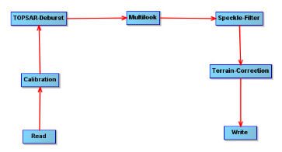
SNAP Application 1/2
SNAP Graph performing 5 tasks
Input: 1 S1 SLC dual polarization product (HH+HV, VV+VH) over NWT
Output: 1 TIF file
Additional data: CDEM over Canada (if not available SNAP downloads it)

Slide 23
SNAP Application 2/2
Requirements: 24GB RAM for JVM (recommended VM with 8vCPU and 32GB RAM)
Processing time: about 6 minutes with recommended settings
Packaged in a Docker container based on CentOS 7
Files to build the container available on GitHub
Execution: snap gpt -c 8G -q 12 S1_Cal_Deb_ML_Spk_TC_cmd.xml -Pinputdata=<input> -Poutputdata=<output without extension>

Slide 24
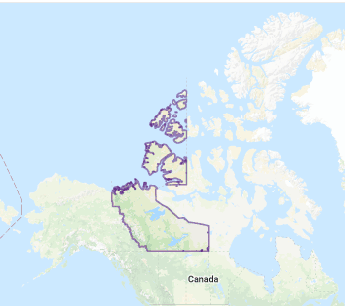
Application Data for the Hackathon
2 time windows:
Beginning of summer (17 to 28 June 2017)
End of summer (09 to 20 Sept 2017)
AOI: North West Territories
Product per time windows:
20 S1 SLC HH+HV
44 S1 SLC VV+VH

Slide 25
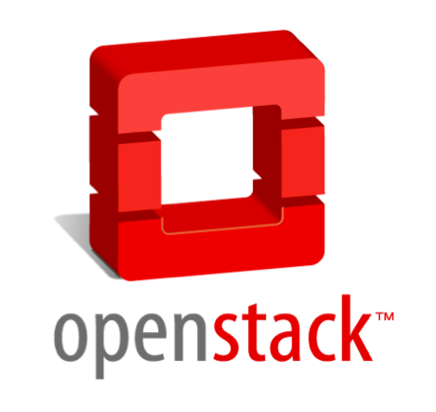
IPT Poland Cloud overview
Web Portal: http://www.cloudferro.com/en/
Accessible via OpenStack API
EO data offer : Sentinel-1,2,3 Landsat-1/8, Envisat MERIS
EO data accessible via dedicated NFS mount

Slide 26
IPT set-up for EOEP hackathon
S1 SLC dual polarization data available in the EO data storage
DEM available in Swift bucket and dedicated NFS export
Dedicated domain for OGC activities (cloud_00254)
Separate project for each participant
To get access to IPT write to a.romeo@rheagroup.com

Slide 27
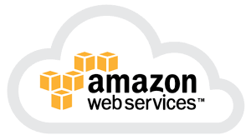
AWS
To ask for resources:
Apply for credits at https://aws.amazon.com/earth/research-credits/
Notify OGC at cloud@opengeospatial.org

Slide 28
Cloud Sigma

Slide 29
OGC EOEP Hackathon
Canadian Forest Service
Use Case Scenario & BorealCloud

Slide 30
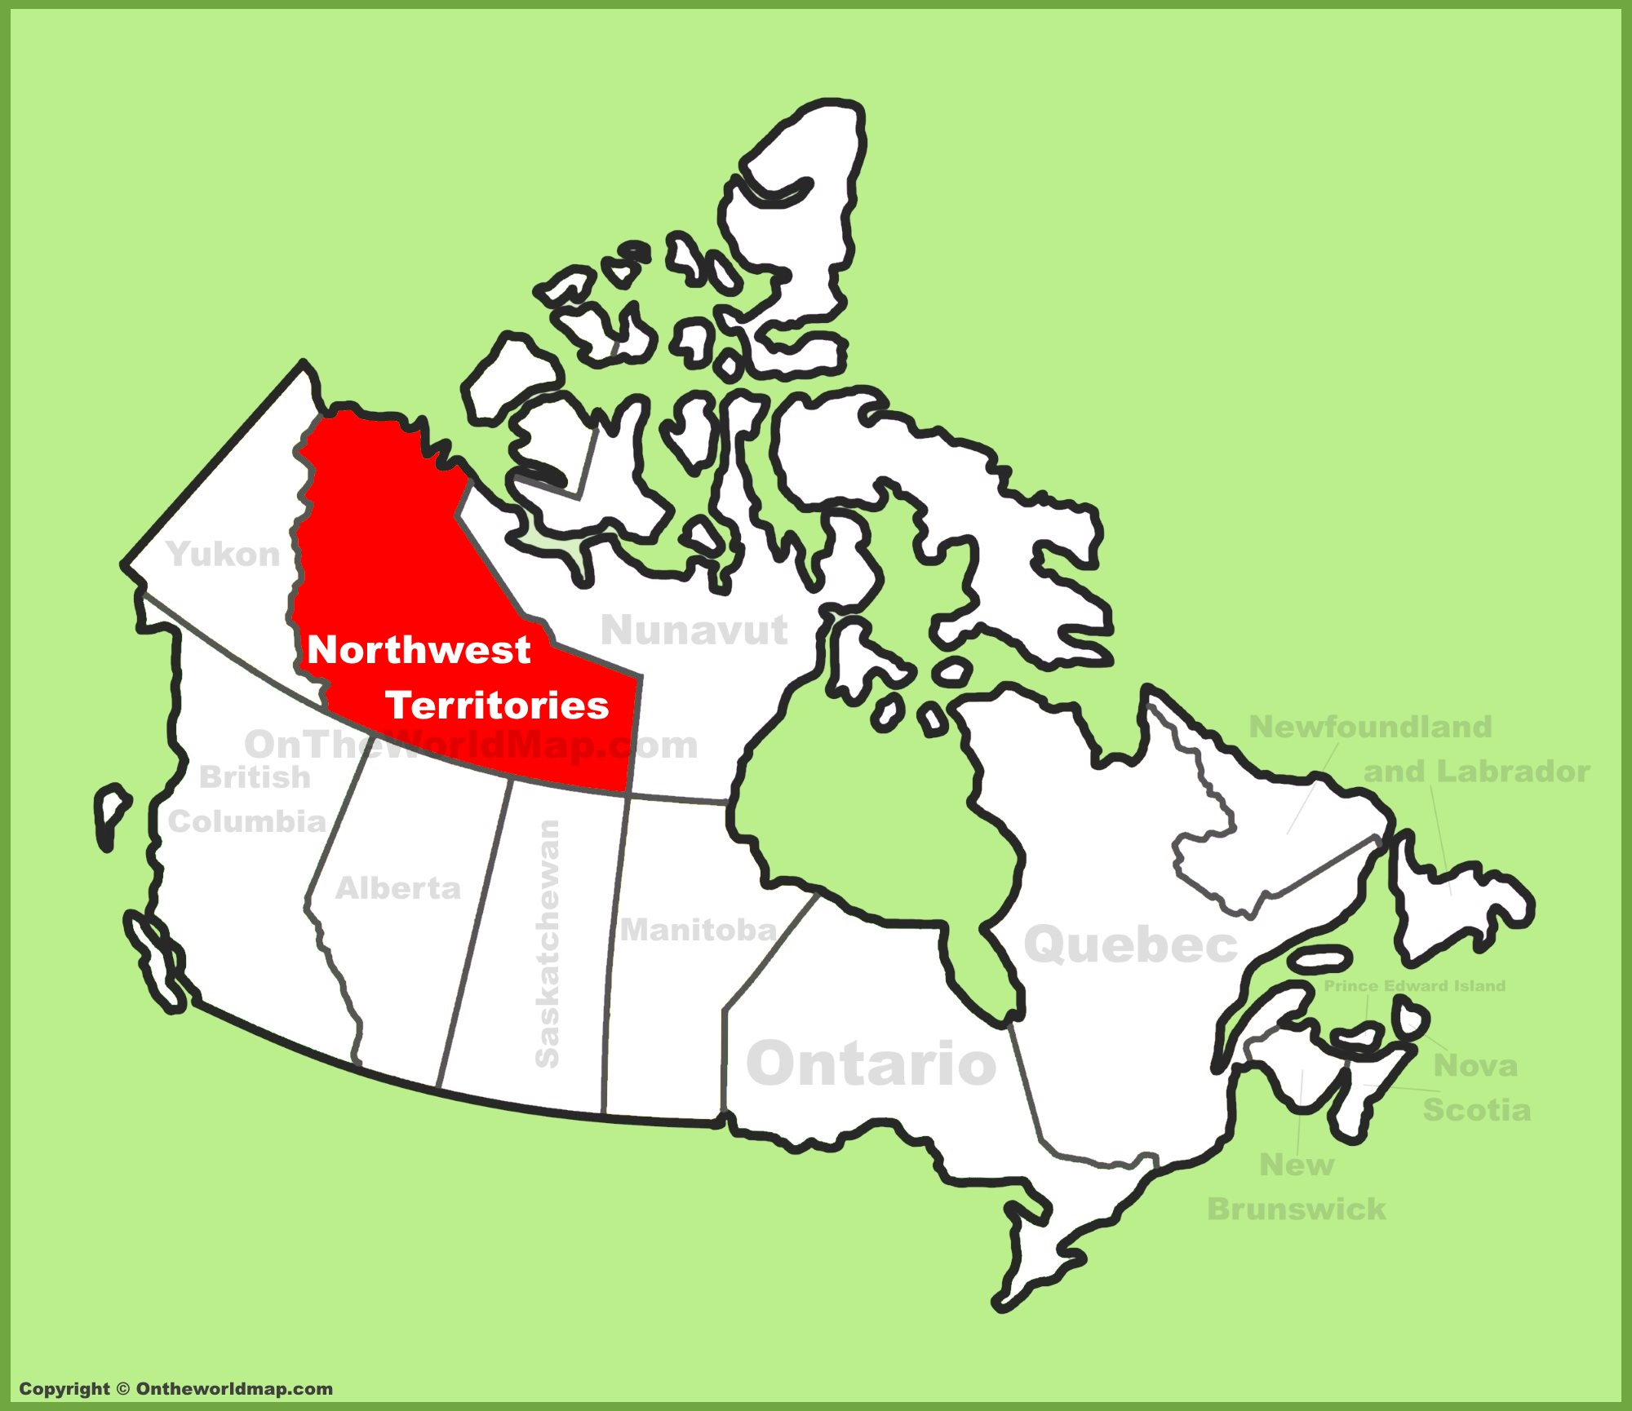
Use Case
Process a collection of Sentinel 1 RADAR data for the entire Northwest Territories at the beginning and the end of the 2017 summer

Slide 31
Northwest Territories
More than 1,300,000 km² (500,000 sq mi)
28 million hectares of forestlands (largely inaccessible)
Large climate variant from north to south
Subartic climate to polar climate
Summers are short and cool (mid teens Celsius)
Winters are long and harsh

Slide 32
Northwest Territories
Large wildfires occurred in 2013, 2014 and 2015
Spatially-extensive, timely and cost effective wildfire mapping and monitoring required to better assess post-fire burns and track the impacts of disturbances on forestlands

Slide 33
Data
Sentinel 1 provides an excellent opportunity to investigate C-band SAR information for mapping wildfires in NWT
ESA providing 128 Sentinel-1 IW images (832 GB) for two coverages (beginning and end of summer 2017) of the entire NWT

Slide 34
Data
Natural Resources Canada is providing a Canadian Digital Elevation Model (CDEM) for terrain correction due to lack of SRTM over 60^{O} North

Slide 35
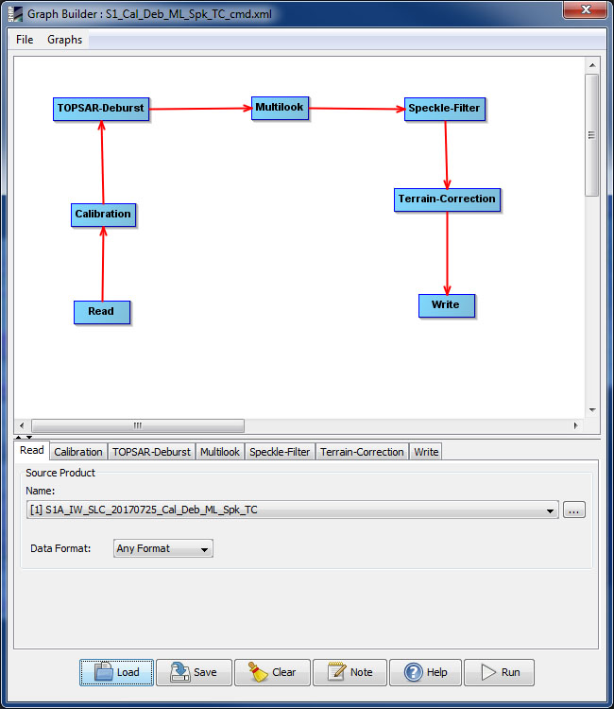
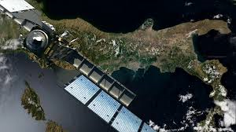

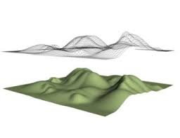
The “Process”
ESA SeNtinel Application Platform (SNAP)

Slide 36
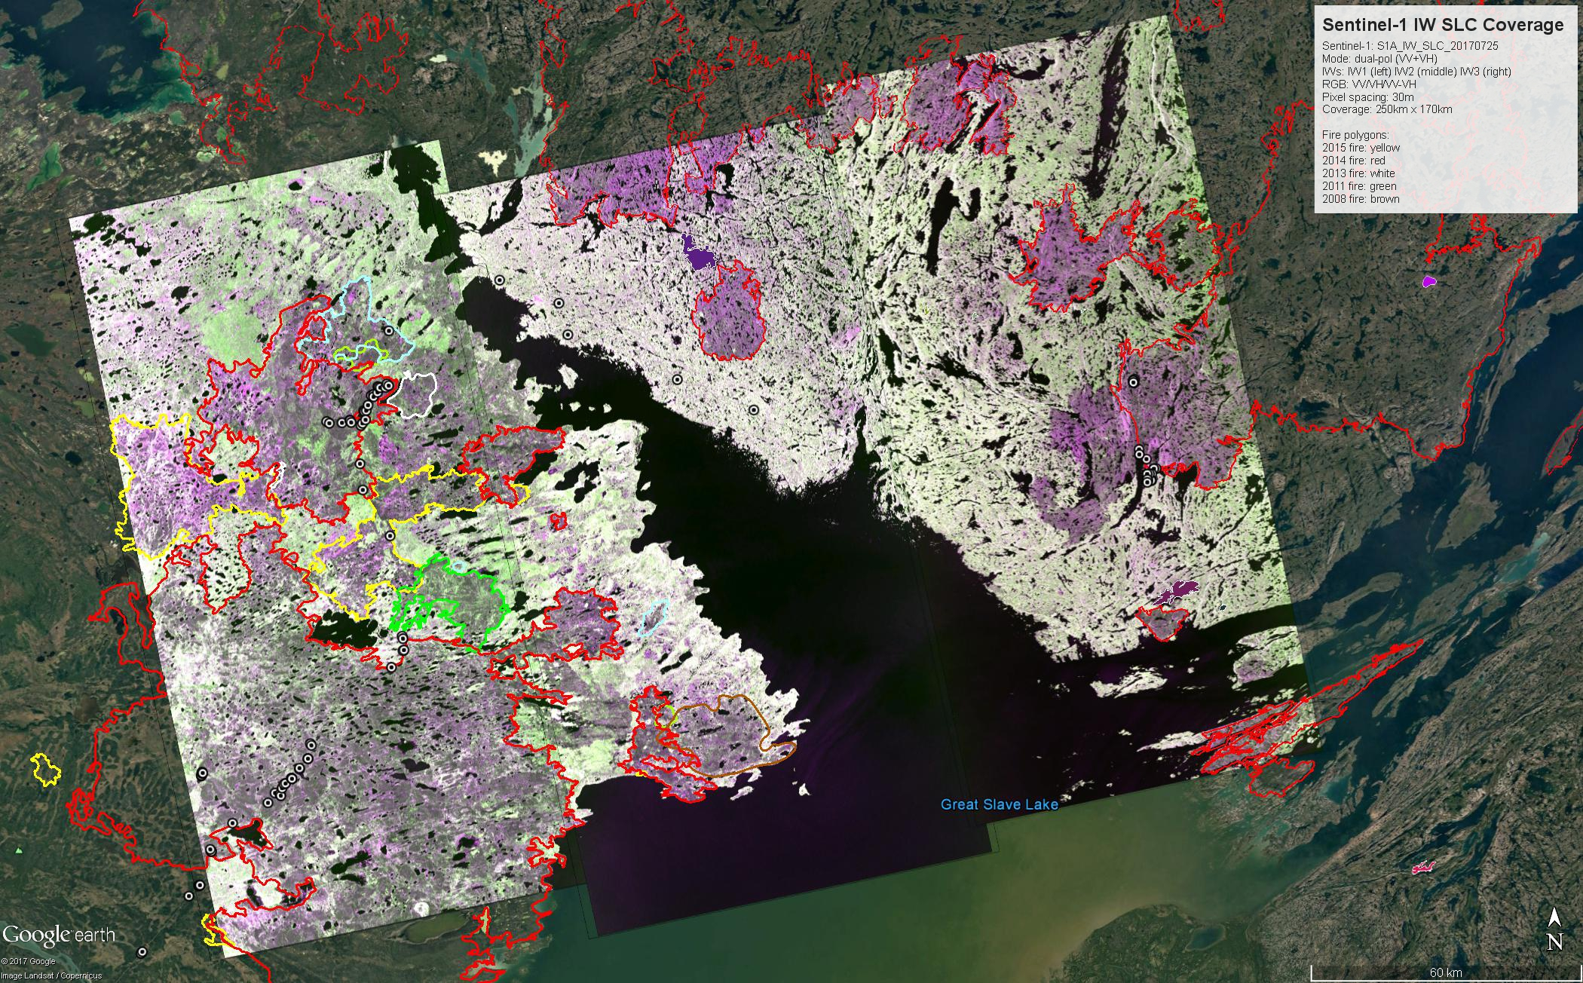
Outputs can then be used to detect fire scars

Slide 37
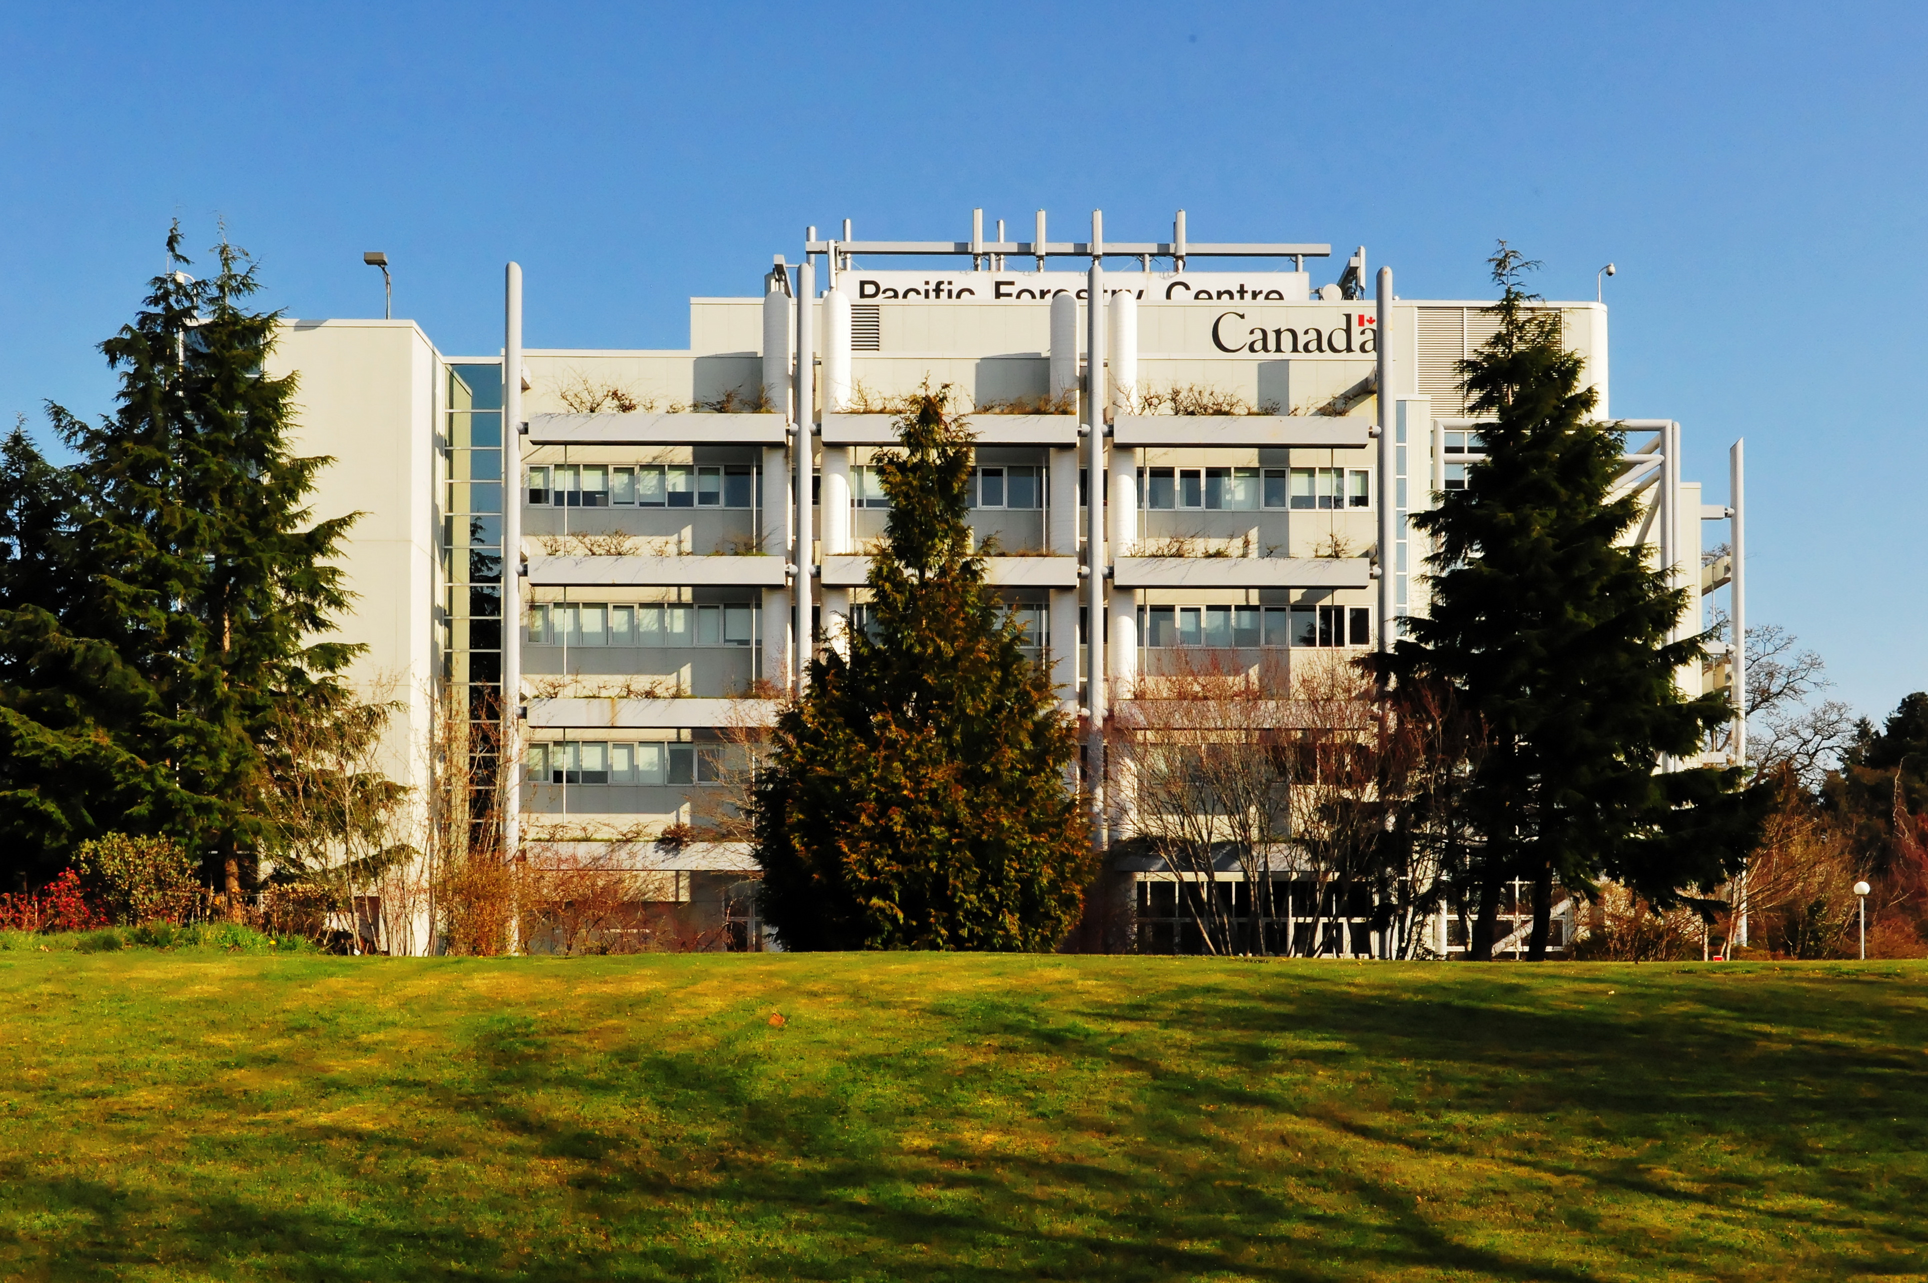
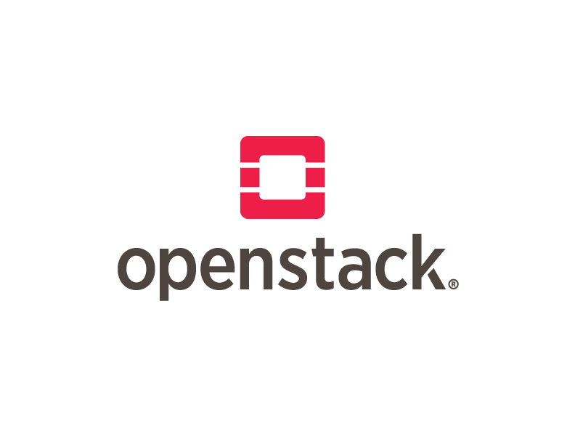
BorealCloud
The Pacific Forestry Centre (Canadian Forest Service) has a private research cloud based on OpenStack - Pike (September 2017)

Slide 38
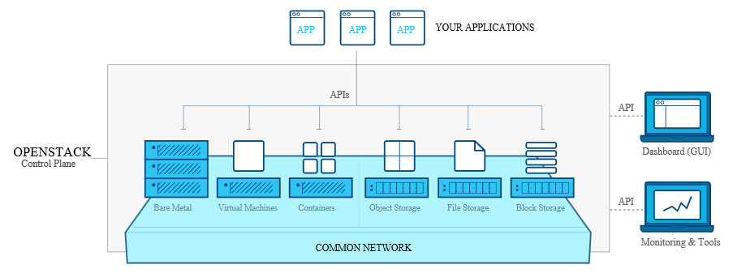
What is OpenStack?
Source: overview.png Retrieved from https://www.openstack.org/software/

Slide 39
OpenStack
Controls large pools of compute, storage, and networking resources all managed through a dashboard that gives administrators control while empowering their users to provision resources
Source: Retrieved from https://www.openstack.org/software/

Slide 40
BorealCloud
Openstack cluster comprising of Xeon , Cuda cores and 400 TB of NAS storage
The research cluster is on a provincial government 1 gigabit up/down network outside of Government of Canada

Slide 41
BorealCloud
Regional Point of Presence for HPC
17 compute + 6 infrastructure nodes based on HP Z840 with OpenStack
952 VCores - hyperthreaded
20736 Cuda Cores
400 Terrabytes of NAS scratch space
34 Terrabytes of CEPH storage

Slide 42
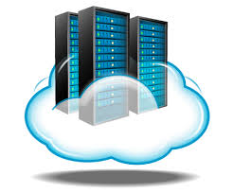

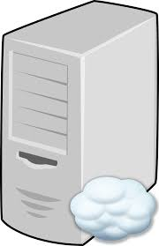

BorealCloud
1 2
borealremote.nfis.org borealcloud.nfis.org/borealjump

Slide 43
More info…
Documentation on access and APIs are available
To get further information including documentation and how to access the BorealCloud, please contact brian.low@canada.ca

Slide 44
